Slide 1
Mini Course: R package development (3)
Rafael Ayala

Slide 2
Day 3
Object oriented programming in R
Accessing web resources in R
Using devtools and usethis for package development
Using roxygen for automated package documentation
Using testthat to check package functionality
Adding graphical user interfaces with shiny

Slide 3
Object-Oriented Programming in R
Three main systems:
S3: based on “class” attributes added to base types, generic functions and method dispatch
S4: more formal extension of S3 with “slots” (named components of objects)
Reference Classes (RC)/R6: encapsulated objects paradigm (i.e., methods belong to the objects, not defined as generic functions) and mutable objects/reference semantics (objects can be modified in place and are not copied when modified).
R6 is similar to OOP in other languages.
R6 implementation is much faster than native RC system
Available through the R6 package

Slide 4
R6 classes
Reference class created with R6Class(), with the following arguments
First argument: class name
“public”: named list of methods (functions) and fields (all other variable types). Access current object with ~$self.
Always return the object itself at the end of each method: call invisible(self)
Special methods:
“print”. Defines how the object is printed
“initialize”. Defines a default constructor (can give defaults, perform checks, etc.)
“private”: fields and methods accessible only from within the class. Access with ~$private
Assign the reference class to an object of the same name, and unitialize instances with reference$new(args)
Useful to model complex systems and create portable structures

Slide 5
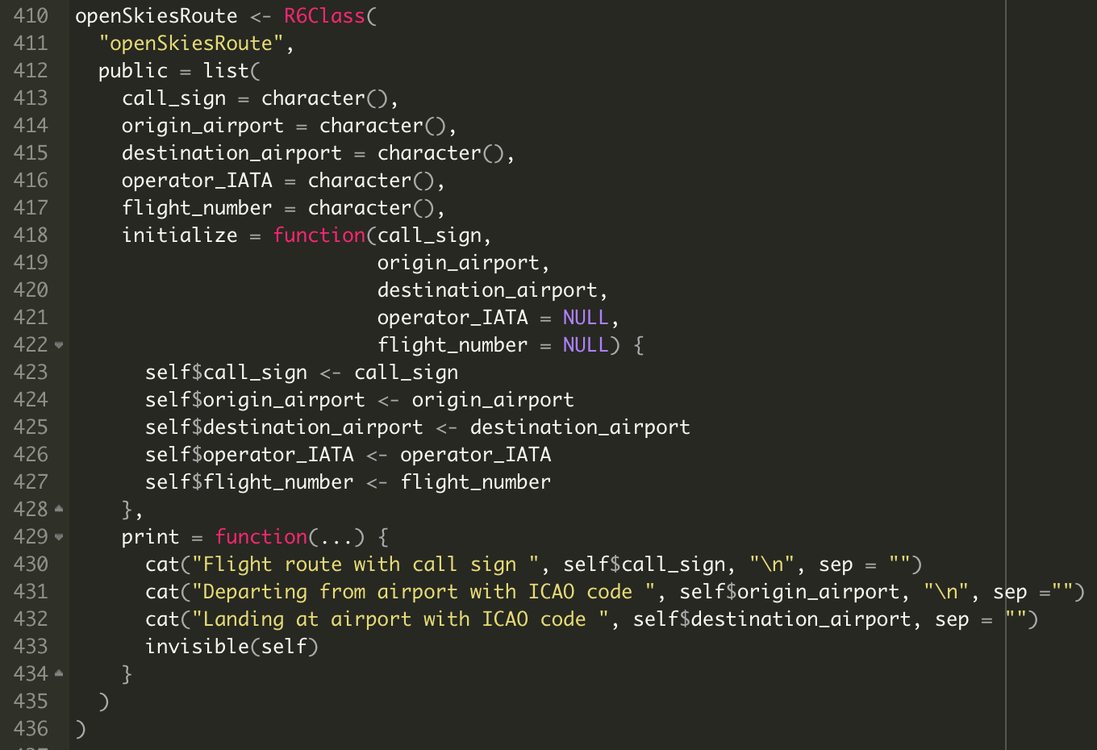
R6 classes

Slide 6
Day 3
Object oriented programming in R
Accessing web resources in R
Using devtools and usethis for package development
Using roxygen for automated package documentation
Using testthat to check package functionality
Adding graphical user interfaces with shiny

Slide 7
Accessing web resources in R
Most frequently: httr package
Identify structure of queries to access the resource:
Base URL
API endpoint
HTTP methods (GET, POST, PUT, etc.)
Query parameters
Authentication, cookies, etc. are easily implemented
Identify structure of the response and parse it
Automatic parsing of json and other content types available
Implement checks for unexpected unavailability of resource, malformed responses, timeouts, etc.

Slide 8
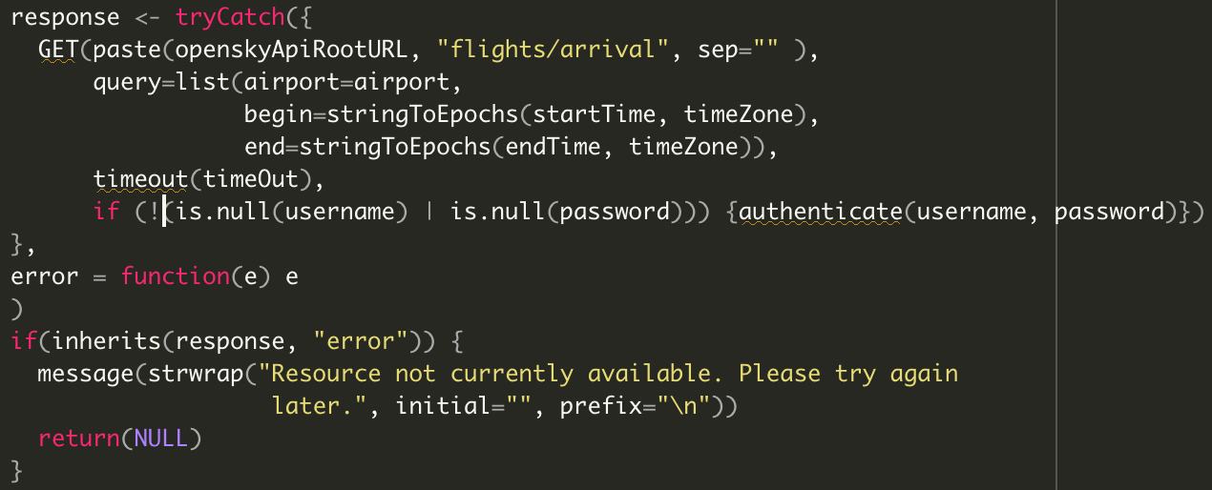
Accessing web resources in R
Example: GET query
GET function:
First argument: target URL
query: named list with query parameters (in a web browser, what goes after “?”)
Additional named/unnamed parameters, usually result of other functions from httr package (timeout(), authenticate(), etc.)

Slide 9
Day 3
Object oriented programming in R
Accessing web resources in R
Using devtools and usethis for package development
Using roxygen for automated package documentation
Using testthat to check package functionality
Adding graphical user interfaces with shiny

Slide 10
What are devtools and usethis?
“The aim of devtools is to make package development easier by providing R functions that simplify and expedite common tasks.”
Lets you build, test, and load your package from within R.
“usethis… automates repetitive tasks that arise during project setup and development…”
Helps reduce user error when editing important files (i.e., DESCRIPTION and NAMESPACE).
Includes a cheatsheet: https://rawgit.com/rstudio/cheatsheets/master/package-development.pdf

Slide 11
Manage package tasks easily
Create a package: create()
Install, load the package: install(), load_all()
Install packages from Github, etc.
install_github(“jamiemkass/ENMeval@dev.branch”)
Write roxygen documentation: document()
Test your package (if unit tests exist): test()
Check your package: check(), check_win_release()

Slide 12
Create package files and file structures easily
Writes to DESCRIPTION
use_description(fields = list(), check_name = TRUE, roxygen = TRUE)
use_package(package, type = "Imports", min_version = NULL)
Use unit testing
use_test(“my_test”)
Licenses
use_mit_license("My Name")
Package data
use_data(data_obj1, data_obj2)

Slide 13
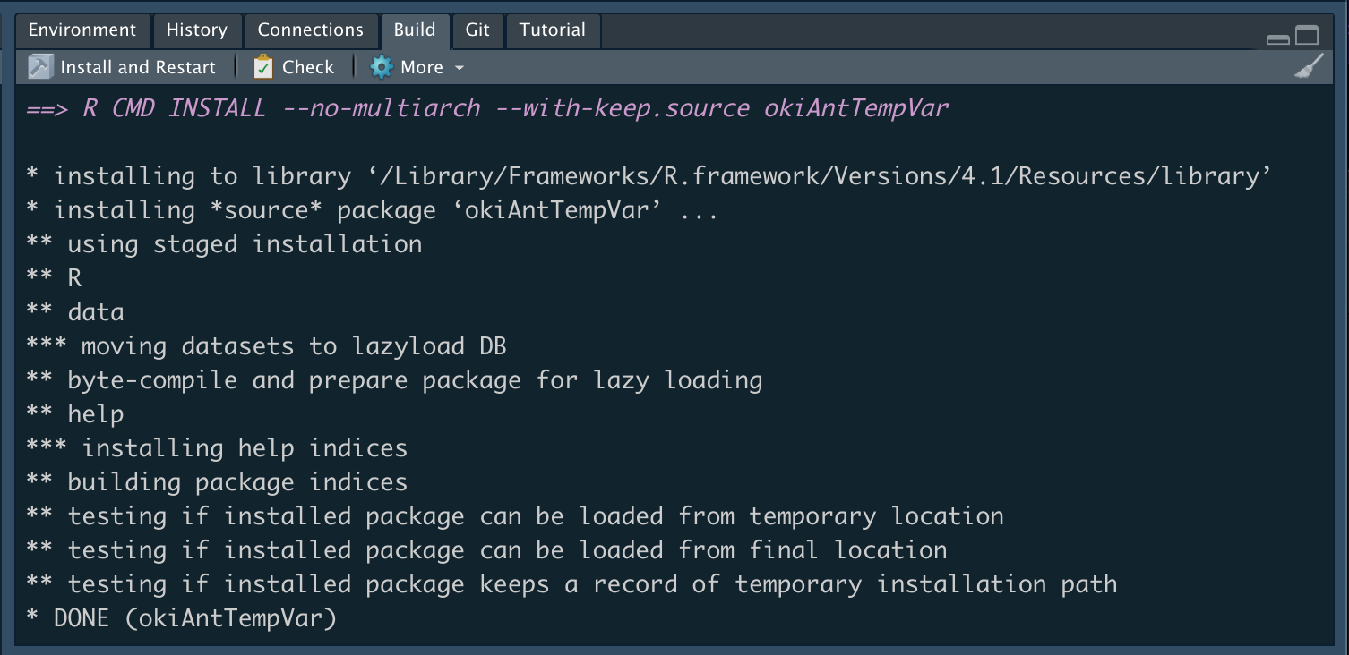
Accessing devtools in RStudio

Slide 14
Day 3
Object oriented programming in R
Accessing web resources in R
Using devtools and usethis for package development
Using roxygen for automated package documentation
Using testthat to check package functionality
Adding graphical user interfaces with shiny

Slide 15
What is roxygen2?
roxygen2 “describes your functions in comments next to their definitions and roxygen2 will process your source code and comments to automatically generate .Rd files in man/, NAMESPACE…”
Makes documenting your package automated and less error-prone.
The roxygen2 code is readable and easy to implement.

Slide 16
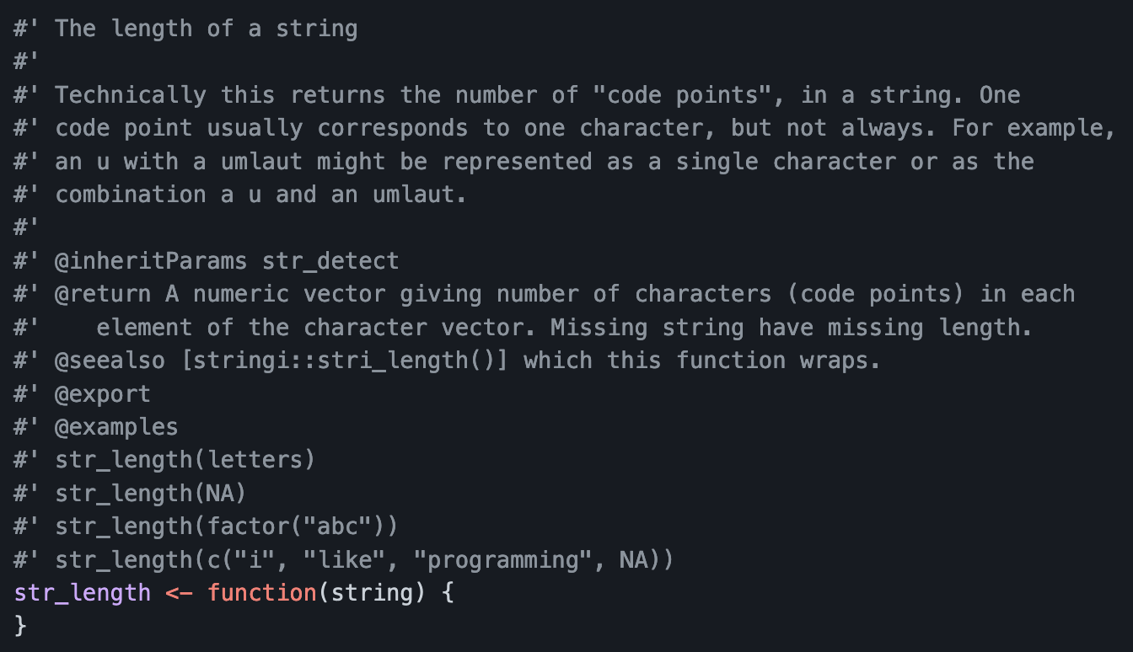
Automated documentation with roxygen comments
From the stringr package:

Slide 17
Automated documentation with roxygen comments
Example from ENMeval

Slide 18
Interfacing with devtools
The devtools::document() function automatically builds .Rd files using roxygen2 comments as reference.
Regular workflow:
Write function.
Write roxygen2 comments.
Run document().
Repeat.

Slide 19
Day 3
Object oriented programming in R
Accessing web resources in R
Using devtools and usethis for package development
Using roxygen for automated package documentation
Using testthat to check package functionality
Adding graphical user interfaces with shiny

Slide 20
Why write unit tests?
Unit tests are functions that test critical functionality of functions.
Package updates often break functions that used to work fine.
Unit tests show you immediately what broke so you can fix it.
Writing unit tests teaches you about all the ways functions can go wrong.
These tests can be automated with testthat.

Slide 21
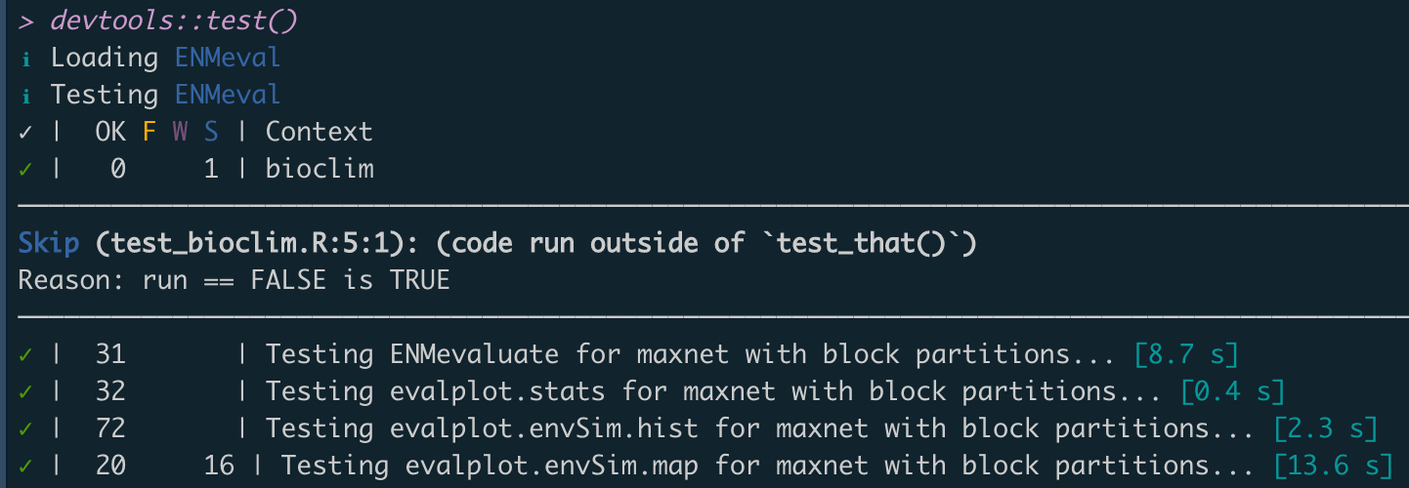
What is testhat?
“testthat is a testing framework for R that is easy to learn and use, and integrates with your existing ‘workflow’.”
Has a suite of functions with names that explain what tests they do.
Shows test progress (with colors) in the console.

Slide 22
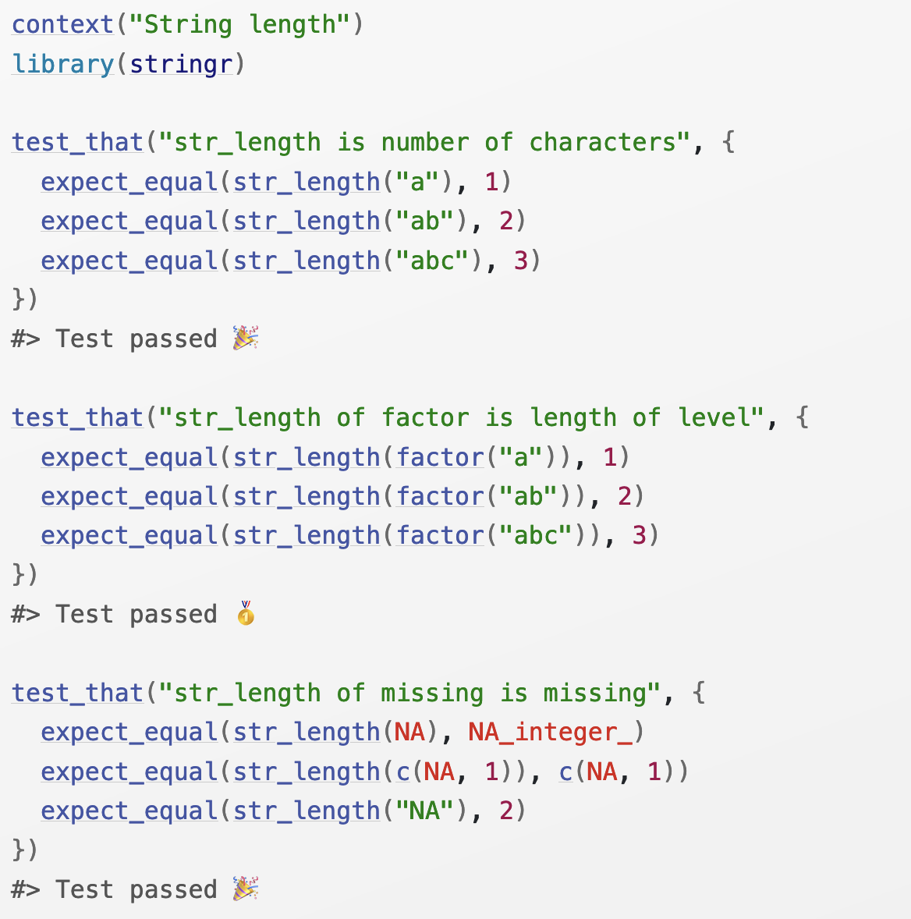
Making unit tests

Slide 23
Interfacing with devtools
Start using testthat with usethis::use_test(“my_test”)
Makes test folder in your package, sets up other file infrastructure, and opens a test file template.
Run your tests with devtools::test()
devtools::check()also runs unit tests as part of the check

Slide 24
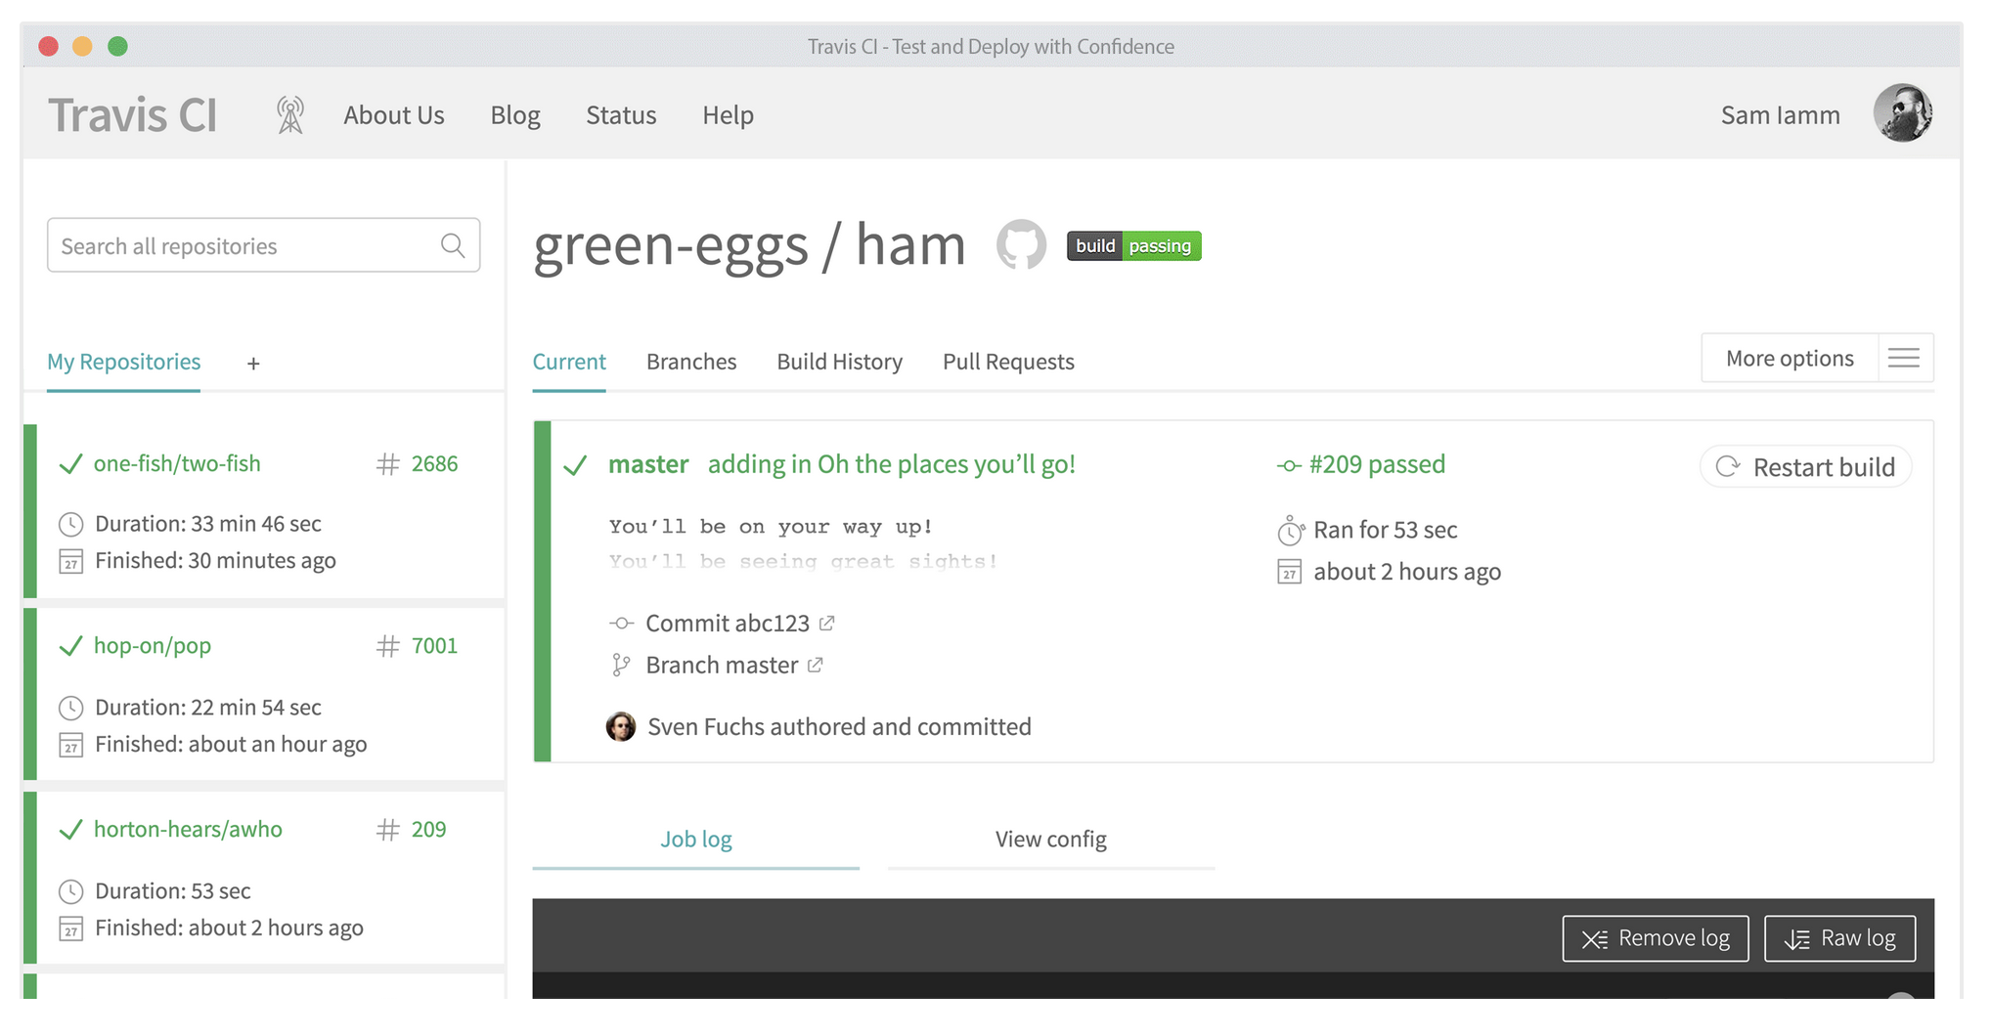
Automated unit testing
Web services can automate unit testing with every git push.
Travis: free in the beginning, but makes you pay if you use it too much
Github Actions: free for most applications, native to Github

Slide 25
Day 3
Object oriented programming in R
Accessing web resources in R
Using devtools and usethis for package development
Using roxygen for automated package documentation
Using testthat to check package functionality
Adding graphical user interfaces with shiny

Slide 26
What is shiny?
“shiny is an R package that makes it easy to build interactive web apps straight from R.”
Making a web app is not a trivial exercise.
shiny lets you code a web app in R and easily view and use it to experiment with Rstudio tools.
These apps can be as simple or complex as you want to make them.
There is a plethora of documentation and tutorials online.

Slide 27
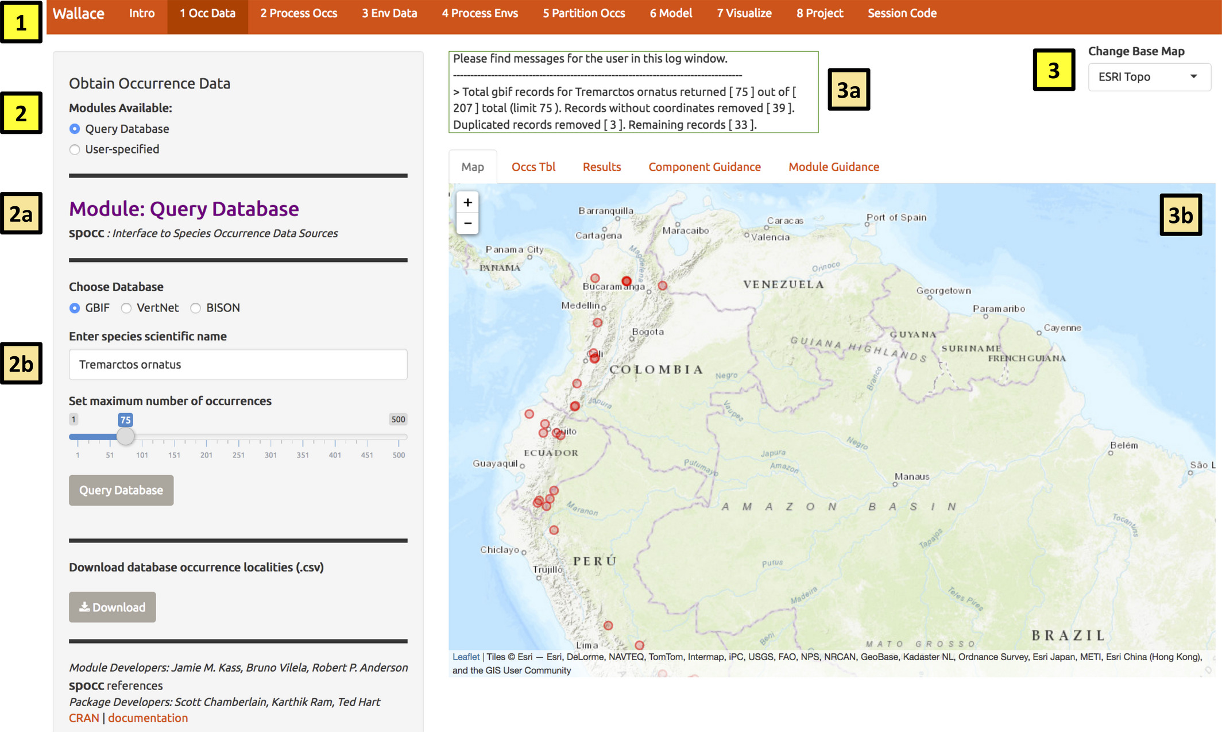
shiny examples: wallace

Slide 28
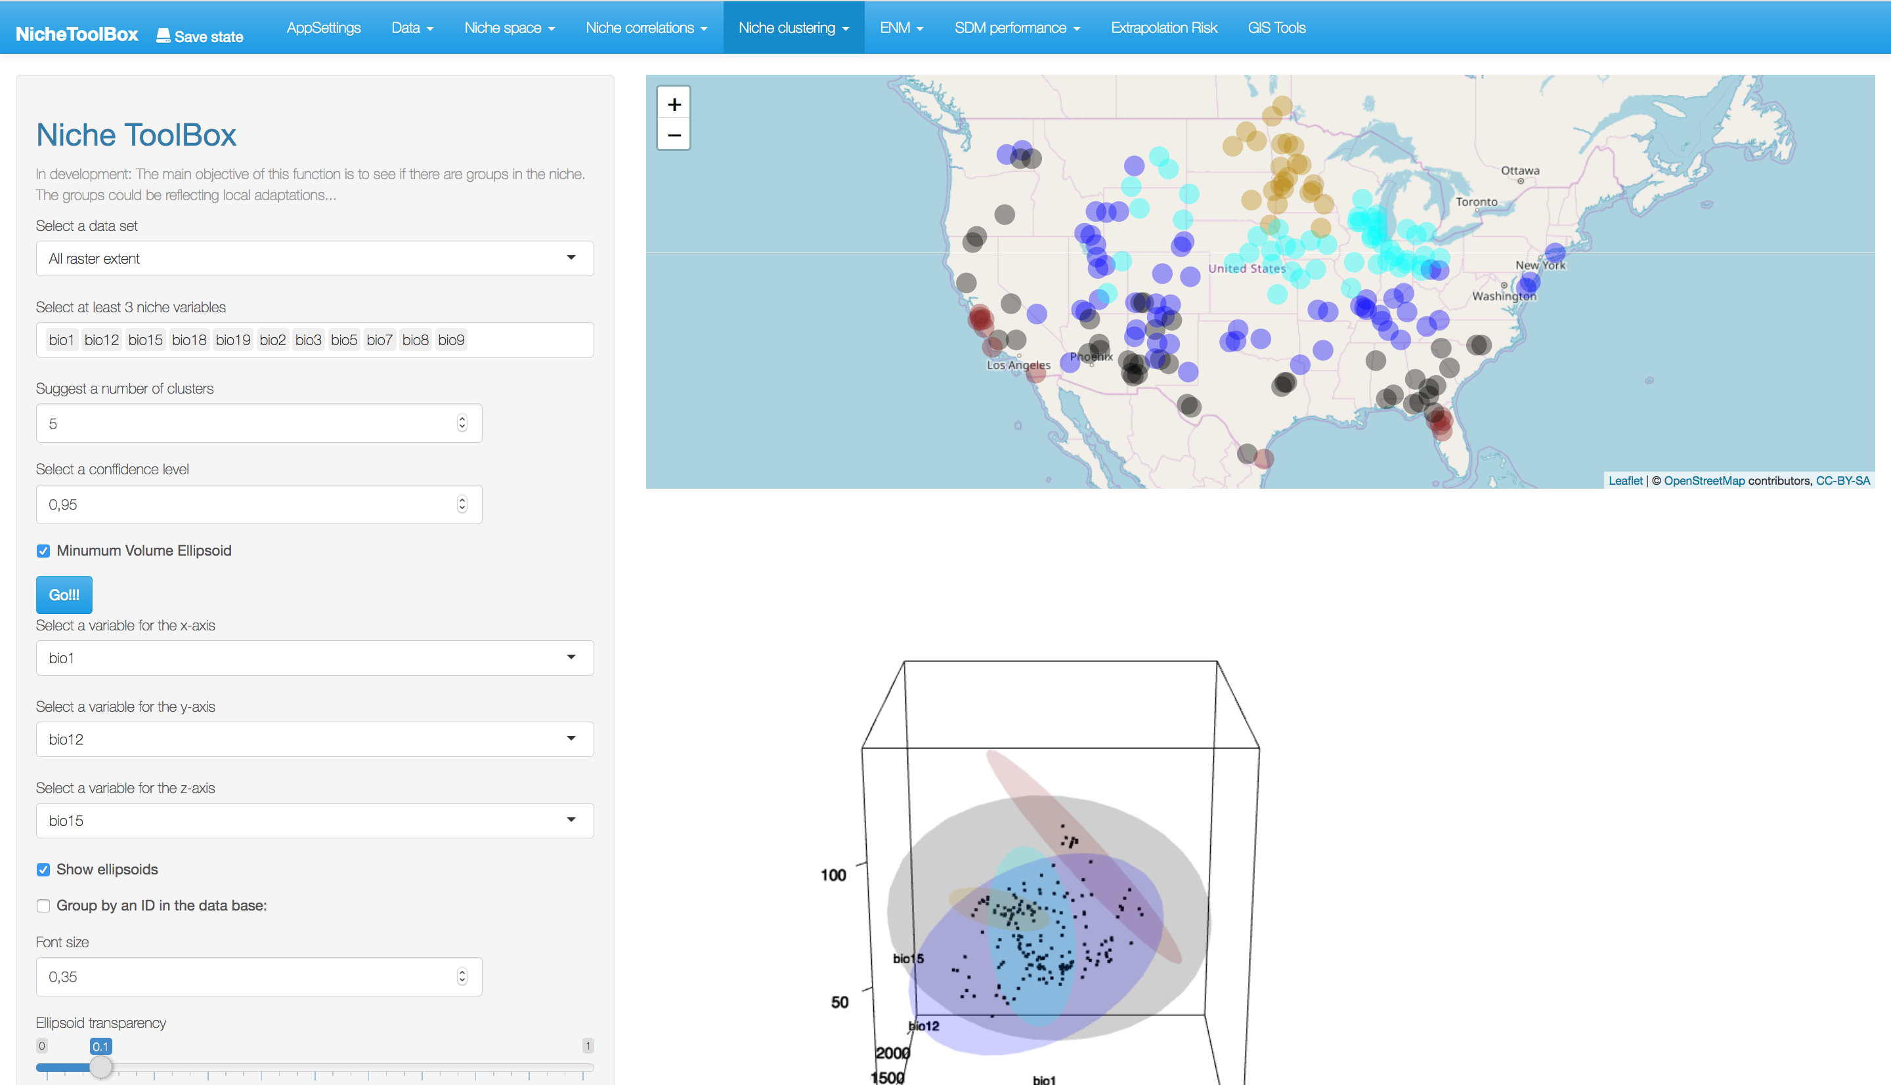
shiny examples: ntbox

Slide 29
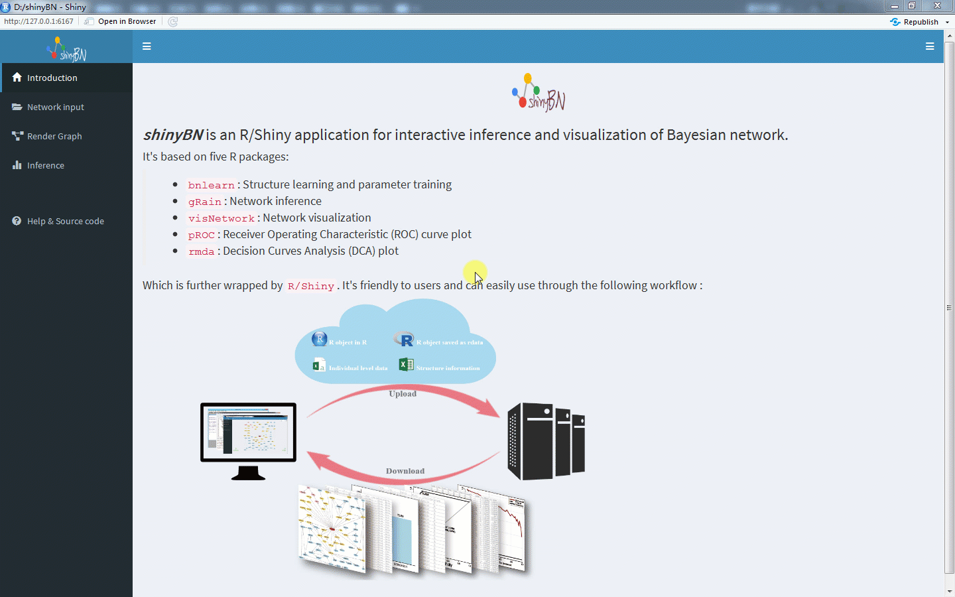
shiny examples: shinyBN

Slide 30
How does shiny work?
Two files: ui.R and server.R, but these can also be combined for simple apps
ui.R controls what appears on the GUI and how the controls work
server.R controls the R functions that get run when GUI controls are activated
These two parts of the app communicate with each other, sometimes in complicated ways.
shiny uses reactive programming to dynamically respond to user actions.
The learning curve can be steep, but online tutorials can help.

Slide 31
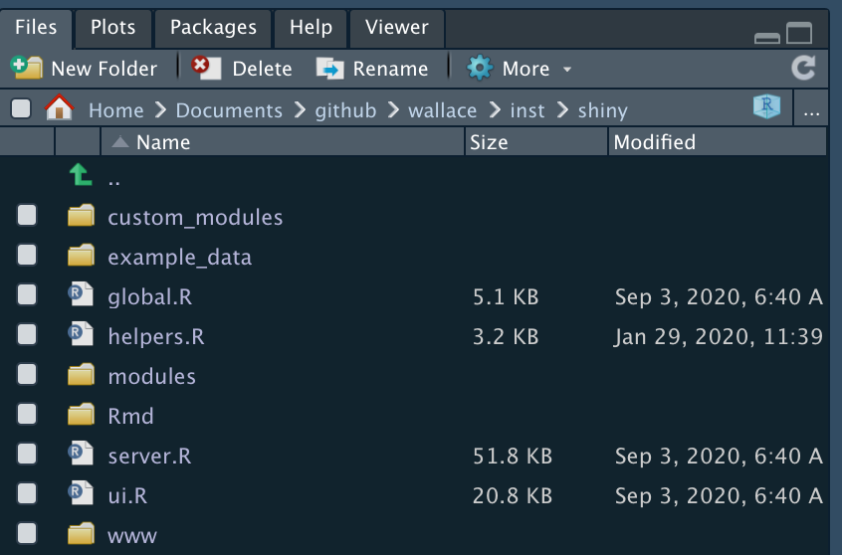
How can you add a shiny app to your package?

Slide 32
Thank you!
References
KB roxygen2 tutorial: https://kbroman.org/pkg_primer/pages/docs.html
KB testthat tutorial: https://kbroman.org/pkg_primer/pages/tests.html
Advanced R testthat tutorial: https://r-pkgs.org/tests.html
Shiny tutorial: https://rstudio.github.io/shiny/tutorial/
Wallace shiny app website: https://wallaceecomod.github.io/

